Slide 1

DEEPFAKE DETECTION PORTAL
We are developing a deepfake detection model that achieves an impressive >80% accuracy in identifying deepfakes. Our solution encompasses multiple components, including API, image deepfake detection, video deepfake detection. This comprehensive approach ensures that we cover a wide range of deepfake scenarios.
Team NoviceNerds

Slide 2
Completion of Task and Working Model
1
API
The /upload endpoint seamlessly feeds files into our state-of-the-art machine learning algorithm, producing results efficiently.
2
Image Deepfake Detection
We have successfully implemented faceapi online sdk to achieve accurate image deepfake detection, leveraging its extensive training over a diverse dataset.
3
Video Deepfake Detection
Using a robust model, we have attained an impressive 80% accuracy in detecting deepfakes in videos. Our model serves as a reliable checkpoint for identifying these fabrications.

Slide 3
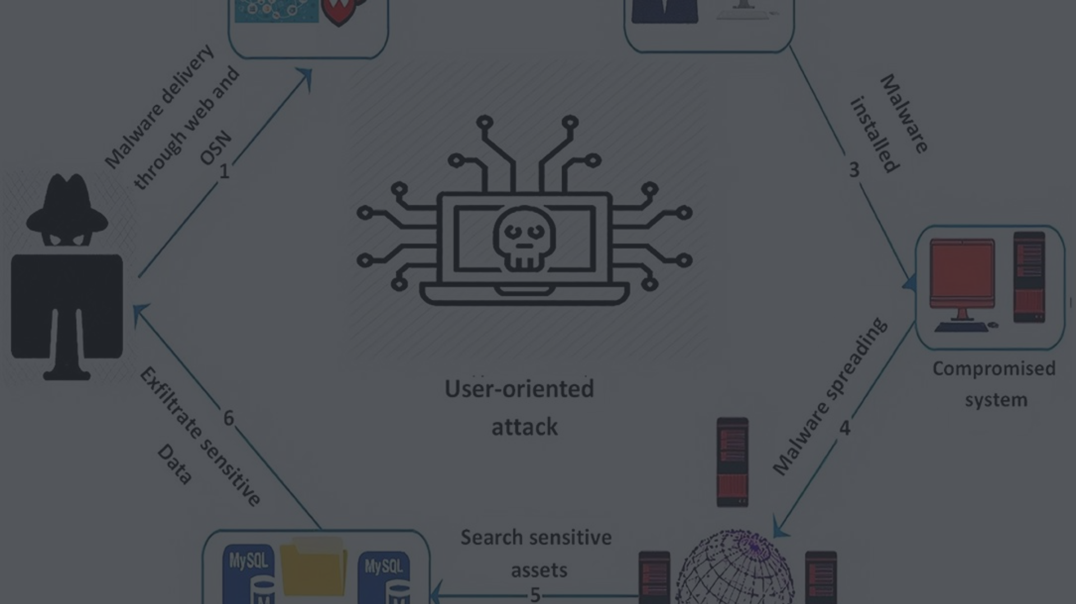
Presentation of Solution
1
Deepfake Detection & Prevention System
We've developed an advanced system with an API endpoint that processes videos through our deepfake detection API. Utilizing the SHA-256 checksum algorithm, it validates the authenticity of the content with 100% Accuracy.

Slide 4
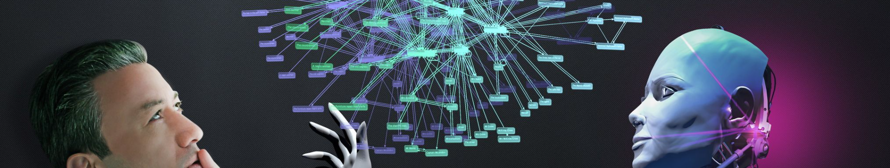
Creativity and Innovation in Solution
Innovative Approach
Our Technology
We have trained our model on heterogeneous datasets that ensure accuracy.
Utilizing ML algorithms, we continuously innovate to stay ahead of rapidly evolving deepfake methods.

Slide 5
Readiness in Implementation
>80%
Accuracy Achievement
Our deepfake detection model attains an impressive >80% accuracy rate, setting a high standard for implementation readiness.

Slide 6




Future Capabilities of Team
Upgraded Audio Model
Supervised Feedback System
We are dedicated to creating our audio model ensuring a robust and reliable solution for audio deepfake detection.
Our future capabilities include implementing a supervised feedback mechanism to continuously refine our model's accuracy based on real-world scenarios.
Live Model Training
We will be training our model further on the basis of videos uploaded without saving them and strengthening our pattern recognition abilities.

Slide 7

Future Workings
Audio Model Advancements
API Functionality Expansion
Working on enhancing the audio model with additional resources to strengthen our deepfake detection capabilities.
Expanding the API functionality to include video-saving capabilities and integrating supervised feedback mechanisms for continuous learning.

Slide 8

Strategic Partnerships and Collaborations
Industry Collaborations
Investor Relations
Exploring strategic partnerships with industry leaders to further fortify our deepfake detection capabilities.
Engaging with tech-savvy investors to support our future endeavors and extend our expertise in combatting deepfake technology.

